Slide 1
Image Encryption using the FEAL Algorithm
BY: Didier Lessage And Robert Veira
CAP 6135 – Spring 2016
University of Central Florida

Slide 2
Outline
Introduction
Development Tools
Research Goals
Implementation
Results
Problems and Issues
Conclusion

Slide 3
Introduction

Slide 4
Introduction
The types of messages that are sent today move beyond just simple text
Also include various files such as photos
Users value security and confidentiality when sharing information online
Facebook
Instagram
Twitter
Notes:
At the beginning of encryption, researchers and users were mainly concerned about encrypting messages just made up of text. However, with present times, users are sharing much more than just simple text messages and text based e-mails. Photos are being shared online through various ways such as through e-mail and through social media websites like Facebook, Instagram, and Twitter. Some of these photos may contain personal or private information that online users may want to limit access to so that only people that they trust can view or access them.

Slide 5
Introduction
How can we secure images?
Through encrypting the image
Lots of research on image encryption
We decided on implementing the FEAL algorithm for Image Encryption
Notes:
One of the ways that images can be secured is through image encryption. Now there is lots of research out there that involves using different encryption algorithms and encrypt / decrypt an image. Out of many, we decided that we would attempt to implement and analyze the FEAL algorithm when used to encrypt and decrypt grayscale images.

Slide 6
Introduction
FEAL Algorithm
Block cipher
Also referred to as Japanese Encryption Algorithm
Similar to Data Encryption Standard (DES) algorithm
Original purpose for text
Can now be used on grayscale image
Notes:
Here’s some information about the FEAL algorithm and how it will be used to encrypt and decrypt images. The FEAL algorithm is a block cipher and it’s also referred to as the Japanese Encryption Algorithm. It’s similar to DES, but it’s much faster. It’s original purpose was to encrypt / decrypt text, but since this paper, it can now be used to encrypt / decrypt grayscale images.

Slide 7
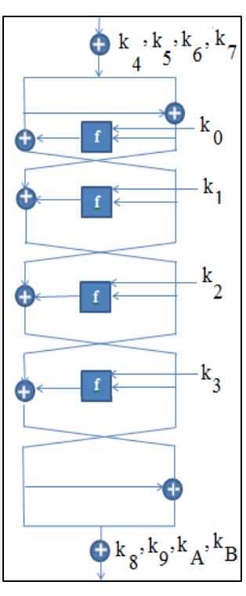
Introduction
FEAL Image Encryption Steps
Using a 64-bit key, generate 12 intermediate keys, each of length 16-bits (Key Scheduler)
Split image into 16x16 blocks
Perform encryption / decryption on block using FEAL as if it were text
Encrypt text 8-bytes at a time
Pictured to the left is an example of the encryption / decryption process in the FEAL algorithm
Notes:
The encryption steps outlined in the paper to encrypt the image using FEAL are as follows:
Use a 64-bit key to generate 12 intermediate keys, each of length 16-bits.
In the FEAL algorithm, this is referred to as the “Key Scheduler” part of the algorithm
Split the image into 16x16 blocks.
Perform the FEAL algorithm on those blocks as if they were text
The specific version of FEAL we are using, FEAL-4, takes in 8 bytes at a time.
This is referred to as the “Data Randomization” part of the FEAL algorithm. It performs

Slide 8
Development Tools
Notes:
Now we will talk about what tools we utilized in the development of the application that encrypts and decrypts images using the FEAL algorithm.

Slide 9
Development Tools
Development IDE
Visual Studio 2015 Community Edition
Programming Languages Used
C++ 11
Software Libraries
OpenCV
C++ Standard Library
Notes:
First of all, we utilized the latest version of the community version of the Visual Studio IDE. It is freely available for anyone to use at home. We decided on using it because we were both familiar with using it in a professional setting. In addition to that, we decided to write a console application in Visual Studio utilizing C++ 11. The main reason for this is that we were both familiar with C++ and also the library we wanted to use for this project, OpenCV, was written in C++. We also utilized the C++ standard library in creating our application.

Slide 10
Development Tools
OpenCV
Open source computer vision and machine learning software library
Has more than 2500 optimized algorithms
Written in C++
Lots of helpful utility methods
Bitwise Operations
Loading, saving, and displaying of images
Notes:
Here’s a little more info about OpenCV…
The OpenCV library is an open source computer vision and machine learning software library that was, according to the OpenCV website, “built to provide a common infrastructure for computer vision applications and to accelerate the use of machine perception in the commercial products.” It has more than 2500 optimized algorithms and is written natively in C++. We utilized it in order to load and display our sample images and to perform low level modifications on our sample images when encrypting and decrypting the images using the FEAL algorithm.

Slide 11
Research Goals

Slide 12
Research Goals
Emulate the FEAL image encryption method used in Nthin, Bongale, and Hegde paper
Compare our results to the results of the emulated work.
Quality of encrypted / decrypted image output
Incorrect key decryption output
Histogram of pre and post encrypted images
Report on the benefits and shortcomings of the FEAL encryption method
Notes:
As we stated in our project prososal, one of our goals was to emulate the FEAL encryption algorithm used in the paper we selected.
Another one of our research goals was to compare our results to the work in the paper. Specifically this meant to compare the quality of encrypted / decrypted image output, see what outputs looked like when the incorrect key was used in decryption, and to plot the histogram values of images pre and post encryption.
Another goal was to report on the benefits and short comings of the FEAL algorithms.

Slide 13
Implementation

Slide 14
Implementation
Create a C++ utilities library
Contained a suite of utility functions used to implement FEAL
Divided into sections of responsibility
F function
Fk function
S-Box function
Key Scheduler Function
Data Randomization Function (DRE)
OpenCV
Used the Mat object for loading / modifying / saving of images
Notes:
In order to implement the FEAL algorithm, we first spent time creating a utilities library in C++. This utilities library contained a suite of utility functions that were used to implement FEAL encryption on images. Each of the functions served a certain purpose in the FEAL algorithm. Some of the parts of FEAL represented by the utility functions were: F function, Fk function, S-Box function, Key Scheduler, and the Data Randomization function.
In addition to that we utilized OpenCV’s Mat class extensively for performing modifications to the test images that we utilized.

Slide 15
Implementation
FEAL Algorithm Process
Loaded an image
Image was split into 8 byte chunks
Each “chunk” is fed into the DRE function
Gate branch
Four data randomizations
Gate branch
Notes:
The actual process that we performed to encrypt the image using the FEAL algorithm is like this:
We first loaded an image using OpenCV.
Then we would split the image into 8-byte chunks. This is the part of our process that wasn’t exactly the same as the paper since the way they had their blocks partitioned was a little unclear to us.
Each chunk is then fed into the DRE (data randomization) function that we created. The data randomization function is made up of a starting and ending gate branch and four data randomizations that are performed on the image chunks in order to encrypt / decrypt them.

Slide 16
Results

Slide 17
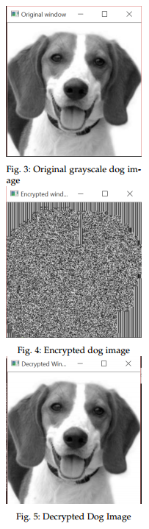
Results
FEAL Encryption was successful
Performed encryption / decryption on several 256 x 256 grayscale images
Quality of encrypted images vs decrypted images was excellent
Notes:
The FEAL encryption implementation was a success! We were able to perform encryption and decryption on several 256x256 grayscale images. The quality of the images when encrypted vs decrypted was excellent. Despite this, we still had some pitfalls / issues that we came across while doing our project.

Slide 18
Results
Problems and Issues
Paper not specific in regards to implementation of encrypting images with the FEAL algorithm
Inconsistencies
Partition image into 16 blocks of dimensions 16x16
In a 256x256 image, you would need 256 blocks of that size to fill image
This is the reason why we partitioned our image differently
Debugging issues
Notes:
Some of the problems and issues that we ran into were due to the fact that the paper wasn’t very specific on the implementation of the FEAL algorithm. In order to help with this, we looked at the original FEAL paper to help clear up some things that were unclear in the paper. Also, there was some inconsistencies that were in the paper, such as the fact that they say to partition the image into 16 blocks of dimension 16x16. But if you had blocks of dimension 16x16 taking up the whole image, you would need to have 256 blocks instead of 16. Because of that, we just decided to encrypt the image 8 bytes at a time.
And last but not least, there were the inevitable debugging issues that plagued us at the end of our project. We had some issues where we were making copies that were preventing the image from being changed and also had some issues where our implementation of the algorithm was slightly off. Thankfully we solved those problems and were able to implement the FEAL algorithm!

Slide 19
Conclusion

Slide 20
Conclusion
Verified that grayscale images can be encrypted using the FEAL algorithm
Actual safety and practicality of FEAL is not as safe as it was originally proposed
Future work is to possibly do the following:
Make our FEAL algorithm implementation work on images larger than 256x256
Broaden the FEAL algorithm image encryption to work for color images
Increase number and complexity of keys used in FEAL algorithm
Notes:
Our conclusion for this project is that we have verified that the FEAL algorithm can be used to encrypt and decrypt grayscale images. Through doing this, we also discovered that the actual safety and practicality of FEAL is not as safe as it was originally proposed. Nonetheless, it’s still a really good algorithm to use to encrypt and decrypt grayscale images.
When it comes to future work, some of the things that would be good to do would be:
Make our FEAL algorithm implementation handle larger images than 256x256
Broaden the FEAL image encryption algorithm to handle color images
Increase the number and complexity of keys used in the FEAL algorithm.

Slide 21
References
den Boer, B. (1988). Cryptanalysis of F.E.A.L. Advances In Cryptology---EUROCRYPT '88 (Davos, 1988),
Shimizu, A., & Miyaguchi, S. (1988). FEAL--Fast Data Encipherment Algorithm. Systems & Computers In Japan, 19(7), 20-34.
Nithin, N and Bongale, Anupkumar M and Hegde, G P (2013) Image Encryption based on FEAL Algorithm. International Journal of Advances in Computer Science and Technology, 2 (3). pp. 14-20. ISSN 2320 - 2602

Slide 22
Thank You!

